Slide 1
Local Anesthetics

Slide 2
Objectives
Explain the conduction pathway of the pain impulses throughout the nerve fibers and the mechanism of action of local anesthetics.
Describe chemical classes of local anesthetics and their pharmacokinetic properties.
ways of the prolongation the of local anesthetics action.
Explain the systemic adverse effects of local anesthetics.

Slide 3
Local anesthetics are drugs that block the sensation (specially of the pain) from a specific area of the body.
may cause other effects as muscle paralysis and suppression of somatic or visceral reflexes.
The pain awareness which called nociception is mediated by primary afferent fibers and relayed by secondary afferent fibers to the brain.

Slide 4
Chemistry of LAs
LAs are amphiphlic weak bases, tertiary amine. PKa 7.5–9.0.
and are usually made available clinically as salts to increase solubility and stability.

Slide 6
Local anesthetics are classified according to their chemical structure into:
Esters: cocaine, procaine, benzocaine, and tetracaine.
B. Amides: Lidocaine, prilocaine, and bupivacaine.

Slide 7
the ester linked LAs are rarely used for infiltration or nerve block Because of:
their short duration.
less intense analgesia and.
higher risk of hypersensitivity.
but are still used topically on mucous
membranes and skin.

Slide 8
L.A are weak bases available clinically as salts to increase solubility and stability.
In the body, they exist either as the uncharged base or as a cation.
The relative proportions of these two forms are governed by their pKa and the pH of the body fluids.
pKa = pH – log [base]/[conjugate acid]

Slide 9
The onset time of blockade is related primarily to the pKa of the LA.
lower pKa (7.6–7.8), lidocaine, mepivacaine are fast acting, because 30–40% LA is in the undissociated base form at pH 7.4 and it is this form which penetrates the axon.
Procaine, tetracaine, bupivacaine have higher pKa (8.1–8.9), only 15% or less is unionized at pH 7.4; these are slow acting.

Slide 10
This ionization of LA is important for their action because the
cationic form is the most active at the receptor site.
the receptor site for local anesthetics is at the inner vestibule of the sodium channel, and
the charged form of the anesthetic penetrates biologic membranes poorly, Thus
the uncharged form is important for cell penetration.

Slide 11
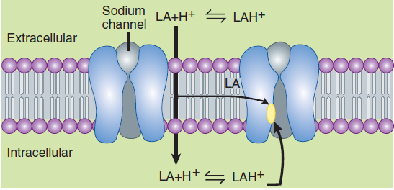

Slide 12
After penetration into the cytoplasm, equilibration leads to formation and binding of the charged cation at the sodium channel.
Drug may also reach the receptor laterally through hydrophobic pathway.
local anesthetics are less effective when they are injected into infected tissues. Why?

Slide 13
Pharmacokinetics
systemic absorption, distribution, and elimination serve only to diminish or terminate their effect.
Pharmacokinetics is important to the anesthetic’s duration of action and the development of adverse reactions, specifically cardiac and central nervous system (CNS) toxicity.

Slide 14
A. Absorption
Systemic absorption of injected local anesthetic from the site of administration is determined by several factors:
dosage, site of injection.
drug-tissue binding.
local tissue blood flow.
use of a vasoconstrictor (eg, epinephrine).
the physicochemical properties of the drug.

Slide 15
intraoral injection results in quicker and higher blood levels than s.c. injection on limbs or trunk.

Slide 16
Esters are metabolized very rapidly mainly by hydrolysis in the blood by circulating cholinesterase into inactive metabolites, therefore they have very short duration of action.
Amides are metabolized in the liver following their systemic absorption with a different rate of metabolism of individual amide drugs.

Slide 17
As a result toxicity from amide-type local anesthetics is more likely to occur in patients with sever hepatic disease.

Slide 18
Mechanism of action of L.A
The primary mechanism of local anesthetics is blocking of the voltage-gated sodium channels of the excitable membrane of nerve axons.
Local anesthetics reversibly block impulse conduction along nerve axons which use sodium channel as the primary means of action potential generation.

Slide 22
When local anesthetics applied to a nerve fiber the threshold for excitation increases, impulse conduction slows, the rate of rise of the action potential declines, the action potential decreases and finally the ability to generate an action potential is completely abolished.

Slide 23
Structure-Activity Characteristics of L.A
The smaller and more highly lipophilic local anesthetics have a faster rate of interaction with the sodium channel receptor.
Lidocaine, procaine, and mepivacaine are more water soluble than tetracaine, bupivacaine, and ropivacaine. The latter agents are more potent and have longer durations of local anesthetic action

Slide 24
Prolongation of LA action
According to their duration of action LA. Are classified into:
A. Low potency Short acting: Procaine, and chloroprocaine.
B. Intermediate potency and duration: Lidocaine, mepivacaine, and prilocaine
C. high potency, Long acting: bupivacaine, and ropivacaine.

Slide 25
The anesthetic effect of short and intermediate acting LA prolonged by increasing the dose or by adding vasoconstrictor agent such adrenaline.
epinephrine (Adrenaline) reduces systemic absorption of local anesthetics from the injection site by decreasing blood flow in these areas. This is important for drugs with intermediate or short duration of action such as procian, lidocian, and mepivacaine.

Slide 26
Vasoconstrictors are less effective in prolonging anesthetics action of the more lipid-soluible, long acting drugs such as bupivacaine and ropvacaine.
The combination should not be applied to the end organs such as the fingers, nose, because it may cause severe vasoconstriction and cut the blood supply which will lead to gangrene of the finger.

Slide 27
Enough amount of adrenaline can be absorbed to the systemic circulation and lead to elevation of blood pressure and cardiac dysrhythmias. Therefore the combination should be avoided in patients with heart disease and hypertension.
Felypressin is an alternative vasoconstrictor to adrenaline. It is synthetic analogue of vasopressin causes less elevation of blood pressure and causes less tachycardia.

Slide 28
Addition of a vasoconstrictor, e.g. adrenaline (1:50,000 to 1:200,000):
• prolongs duration of action of LAs by decreasing their rate of removal from the local site into the circulation.
• enhances the intensity of nerve block.
• reduces systemic toxicity of LAs: rate of absorption is reduced and metabolism keeps the plasma concentration lower.

Slide 29
provides a more bloodless field for surgery.
• increases the chances of subsequent local tissue edema and necrosis as well as delays wound healing by reducing oxygen supply and enhancing oxygen consumption in the affected area.
• may raise BP and promote arrhythmia in susceptible individuals.

Slide 30
The LA often fails to afford adequate pain control in inflamed tissues. The likely reasons are:
a. Inflammation lowers pH of the tissue—greater fraction of the LA is in the ionized.
b. Blood flow to the inflamed area is increased — the LA is removed more rapidly.
c. Reduced Adr effectiveness of.
d. Inflammatory products may oppose LA action.

Slide 33
Routes of administration of LA
Topical application as solution, cream and spray.
infiltration through injection in the vicinity of peripheral nerve endings.
Major nerve trunk block and Field block.
Injection into the epidural or subarachnoid spaces surrounding the spinal cord.
Intravenous regional anesthesia is used for short surgical procedures of upper or lower extremities.

Slide 34
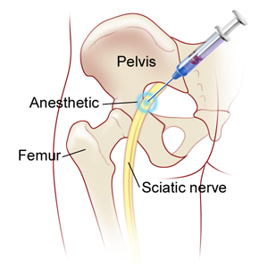

Slide 35
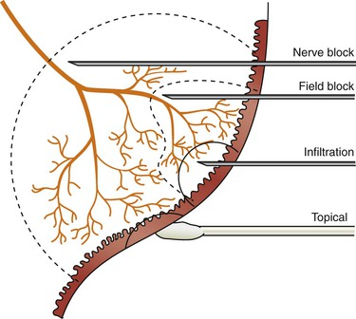

Slide 36
Adverse effects of LA
CNS toxicity: all local anesthetics can produce sleepiness, restlessness, auditory and visual disturbance when high plasma concentration are produced after rabid absorption or inadvertent intravascular administration
At higher concentration, nystagmus and muscular twitching occur followed by tonic-clonic convulsion.

Slide 37
Convulsions can be prevented by administration the smallest effective dose of the local anesthetics required and by avoiding inadvertent intravascular injection.
When large dose is required , premedication with a parenteral benzodiazepines provides significant prophylaxis against local anesthetics-induced CNS toxicity.

Slide 38
2. Cardiovascular system: local anesthetics block cardiac sodium channels and at higher concenteration of local anesthetics, myocardial contractility depress and produce arteriolar dilation leading to systemic hypotension.
3. Allergic reactions: the ester- type local anesthetics are metabolized to o-aminobenzoic acid derivatives. These metabolites are responsible for allergic reactions in a small percentage of patients.

Slide 39
Individual local anesthetics
1. Articaine
dental anesthetic in April 2000.
has enhanced lipophilicity, and thus improve tissue penetration, shorter plasma half-life (20 min.), better therapeutic index with respect to systemic toxicity.
widespread popularity in dental anesthesia, considered to be more effective, and possibly safer, than lidocaine.

Slide 40
2. Lidocaine (Lignocaine)
the most widely used LA.
Injected around a nerve, it blocks conduction within 3 min, whereas procaine may take 15 min; also anaesthesia is more intense and longer lasting.
Vasodilatation occurs in the injected area. It is used for surface application, infiltration, nerve block, epidural and spinal anaesthesia. Cross sensitivity with ester LAs is not seen.

Slide 41
early central effects of lidocaine are depressant, i.e. drowsiness, mental clouding, altered taste and tinnitus.
Overdose causes muscle twitching, convulsions, cardiac arrhythmias, fall in BP, coma and respiratory arrest.
lidocaine has an excellent record as an intermediate duration anesthetic, and remains the reference standard against which most anesthetics are compared.

Slide 42
3- Bupvacaine: Is long acting its half live and its used for periphral nerve block, and for epidural and spinal anesthesia.
4- Cocaine: The sole medicinal use of cocaine is as surface anesthetic usually as 4% solution. even as a surface anesthetic can cause serios adverse affects. Cocaine prevents the uptake of catecholamines into sympathetic nerve endings and cause vasoconstriction.

Slide 43
5- procaine: Has short duration of action and is less used.
6- Mepivacaine And articaine: Are intermediate acting used in dentistry with or without adrenaline.

Slide 44
Thank you

